Slide 1
HW 9 – Prediction challenge 1
Ryan Coslove rmc326

Slide 2
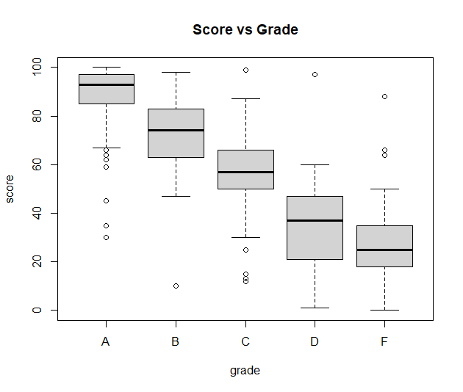
Score
The Grades had many overlaps in their ranges. Therefore people with the same scores could have received different grades. What factors the grades?
Observations:
Between 1-88 can be a F, D, C, or B
Between 30- 88 can be a F,D,C,B or A
Between 30-100 can be a F,D,C,B or A

Slide 3
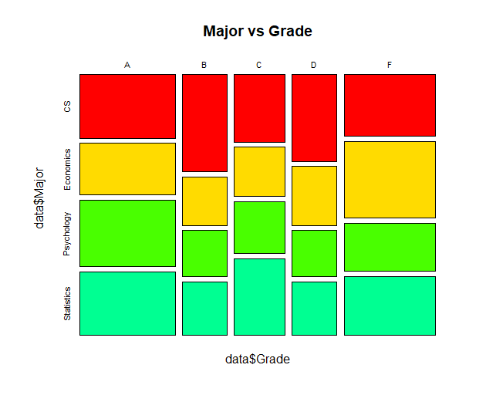
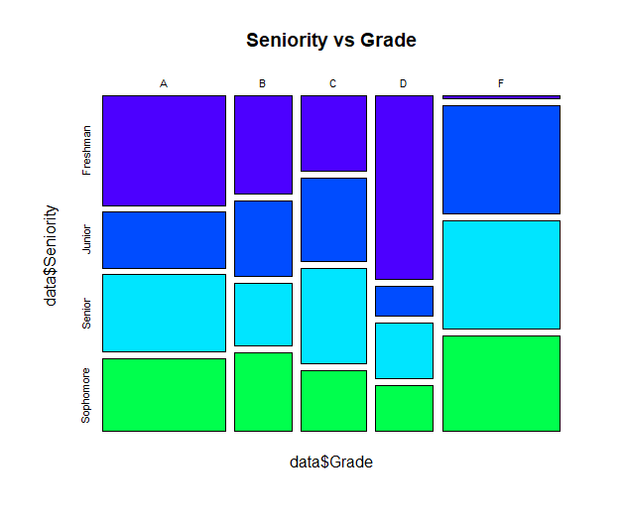
Factors?
The categorical variables are fairly evenly distributed so nothing is particularly obvious in patterns. These might be the grade tiebreakers, but it is not obvious.

Slide 4
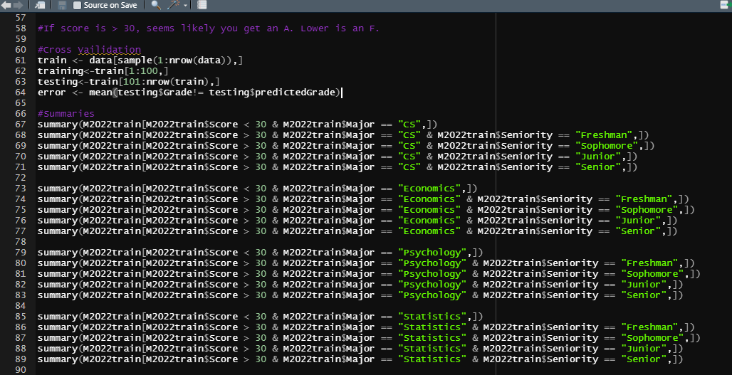
Prediction Model
I created Summaries to see relationships between majors and seniority statistics.
I found that Economic students tended to fail the most, and CS students had the most A’s

Slide 5
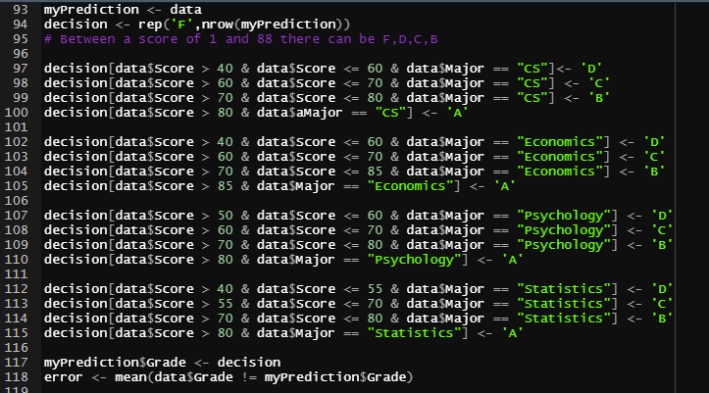
Prediction Model
My prediction model tried to divide the grades based on major and seniority relationships.
For example, CS freshmen failed the least.
Therefore I divided the decisions by scores in relation to their major and seniority

Slide 6
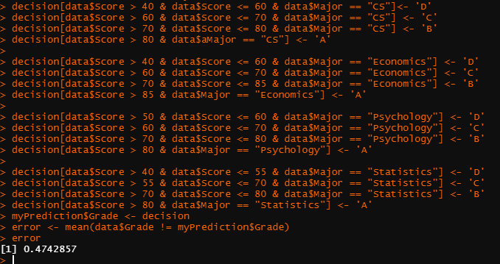
Final prediction model
With an error percentage of around 47%, I applied this prediction model to my test data, several times, and was able to attain astable error percentage of around 47% most of the times.
• Yet again, I took many more attempts at improving my prediction model, but this was the best that I could achieve.
• I did not submit this prediction to Kaggle, and my Kaggle score was 0 with the file I submitted. Unfortunate.

